Slide 1
Fuel cells
https://pixabay.com/photos/puzzle-icon-blue-sky-ecology-2198142/

Slide 4
Yesterday's technology?
Current vehicle technology uses fossil fuels or battery power.
What problems are associated with using fossil fuels and batteries?
https://en.wikipedia.org/wiki/Fossil_fuel
By Chad Teer from Coquitlam, France - Flickr.com - image description page, CC BY 2.0, https://commons.wikimedia.org/w/index.php?curid=341183

Slide 5
Fuel cells, powering the future?
Fuel cells can have near-zero emissions, are quiet and efficient are safer to dispose of and unlike batteries don’t run down.
Proton-exchange-membrane fuel cell technology and next-generation fuel cell concepts are being explored for space vehicle applications, such as the Mars Flyer, and for aircraft power and propulsion systems. Credit: NASA

Slide 6
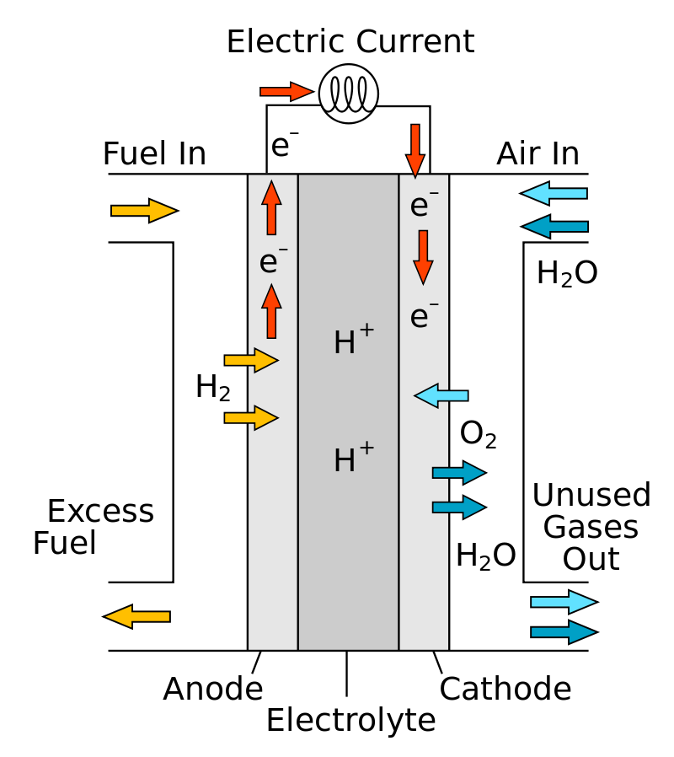
A fuel cell is a device that produces a voltage continuously when supplied with a fuel and oxygen. In a hydrogen-oxygen fuel cell, hydrogen and oxygen are used to produce a voltage. Water is the only product.
Write a balanced equation for the overall reaction in a hydrogen-oxygen fuel cell.
Two separate reactions happen, one on each side of the fuel cell.
1. On one side, hydrogen molecules lose electrons and form hydrogen ions: 2H₂ → 4H⁺ + 4e⁻ | The two products reach the other side of the cell, hydrogen ions through a membrane and electrons through the electrical circuit. | 2. On the other side, hydrogen ions react with oxygen molecules and electrons to form water: 4H⁺ + O₂ + 4e⁻ → 2H₂O
By R.Dervisoglu - Own work, based on http://en.wikipedia.org/wiki/File:Solid_oxide_fuel_cell.svg, Public Domain, https://commons.wikimedia.org/w/index.php?curid=19314043

Slide 7
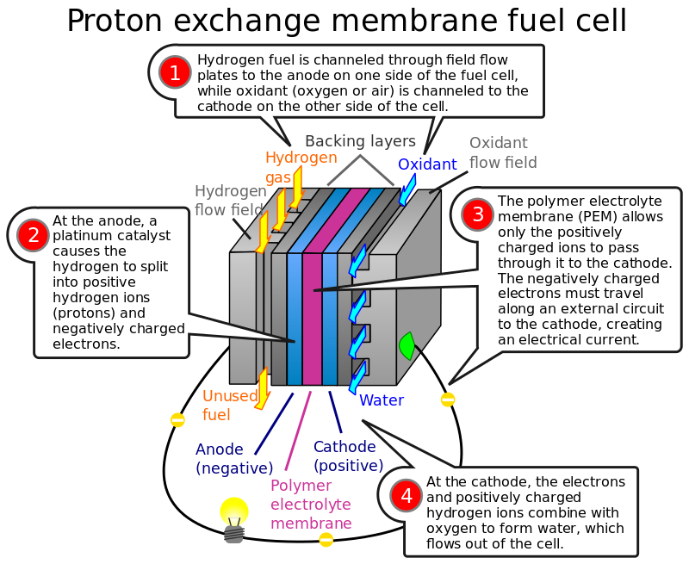
By Jafet at English Wikipedia - Transferred from en.wikipedia to Commons by Kpengboy., Public Domain, https://commons.wikimedia.org/w/index.php?curid=8680999

Slide 8
What a waste!
World wide we produce 6.4 trillion litres of urine!.
The sewage is collected and then treated or disposed of.
But what if, along the way, there was a means to make the sewage do something useful? Human urine is rich in nutrients, and some bacteria actually thrive on eating those nutrients.
Scientists have been showing how human urine can be used to generate electricity in a microbial fuel cell which can be produced for about £1.

Slide 9
Pee Powered fuel cells.
Video: https://www.youtube.com/watch?v=A3dyegoKX_U&feature=youtu.be

Slide 10
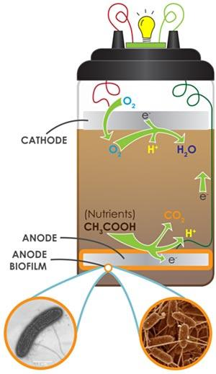
A microbial fuel cell, is a device that can use microbes to make electricity. It is a renewable, clean source of energy which can even use urine as fuel. Bacteria eat the nutrients in the urine, and in turn, produce electrons. These electrons can be harnessed to create electricity.
This diagram shows the reactions taking place in a microbial fuel cell (or MFC) that make it generate electricity. (Wikimedia Commons, 2010, MFCGuy2010)

Slide 11
Affordable, clean energy for all. An estimated 1.1 billion people – 14% of the global population – do not have access to electricity according to Energy Access Outlook 2017.
List all the ways you use electricity at home.
What would you most miss if you had no access to electricity?
Imagine you were given some microbial fuel cells, how would that change things?
Make a justified argument in support of further improving and distributing microbial fuel cell technology.

Slide 12
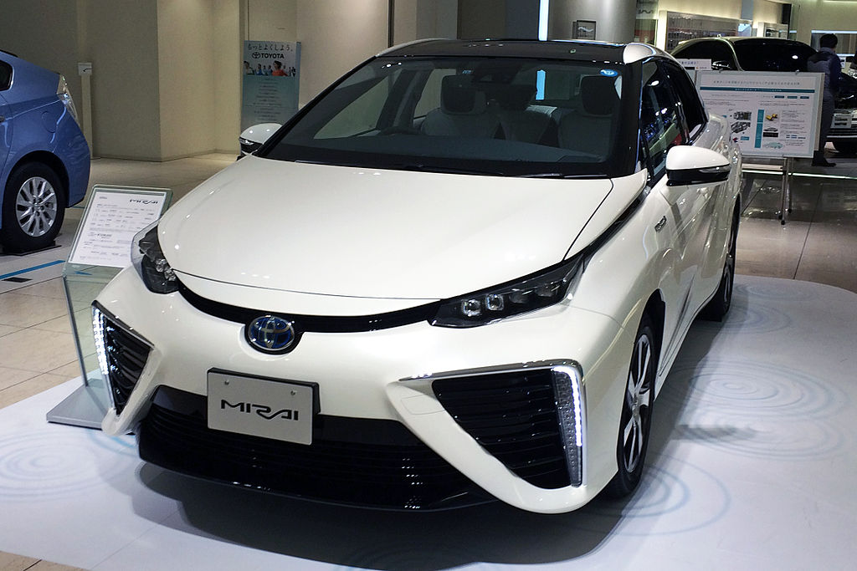
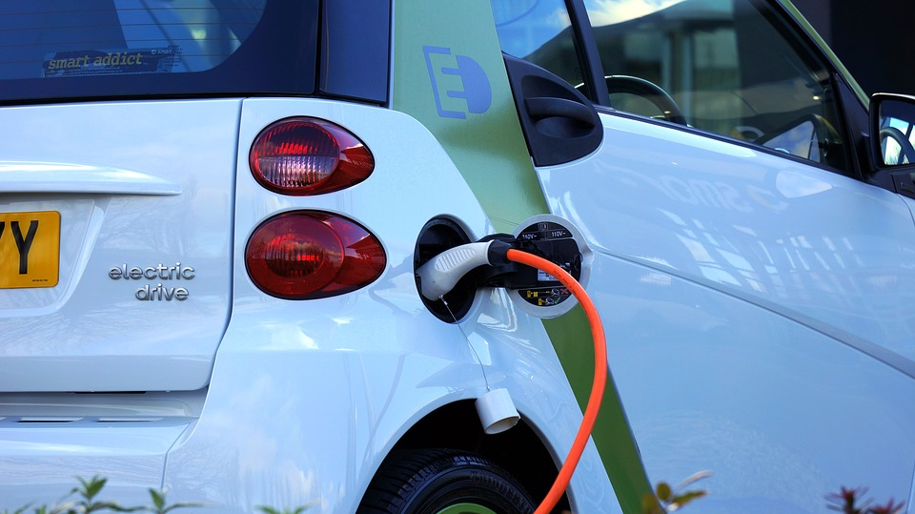
Comparing and contrasting.
Fuel Cells
Rechargeable batteries.
Notes:
https://upload.wikimedia.org/wikipedia/commons/thumb/8/8c/Toyota_mirai_trimmed.jpg/800px-Toyota_mirai_trimmed.jpg http://cdn.zmescience.com/wp-content/uploads/2017/07/electric-car-1458836_960_720.jpg

Slide 13
An automobile company is looking to invest in new technology to replace fossil fuel powered internal combustion engines by 2025. Work in pairs to produce a report which presents the advantages and disadvantages of hydrogen fuel cells and rechargeable batteries. Each person will evaluate one technology.
Hydrogen fuel cells
Advantages | Disadvantages
Evaluation (on balance I think…because…)

Slide 14
Evaluating fuel cells- sort the statements into pros and cons
There are no natural reservoirs of pure hydrogen; it must be extracted from compounds such as natural gas or water. | Hydrogen is very difficult to store and transport in a vehicle unless it is compressed to thousands of pounds per square inch (psi). | When natural gas (basically methane, a lightweight molecule made of carbon and hydrogen) is exposed to steam under high temperatures in the presence of a catalyst, it frees the hydrogen. However, the process itself also produces substantial amounts of CO₂.
The only exhaust from fuel-cell-powered vehicles would be water vapor. | A hydrogen-oxygen fuel cell is an electrochemical cell – that is, it converts chemical energy in fuels directly to electrical energy. | They are very light.

Slide 15
There are over a billion motor vehicles in the world.
Fuel cell technology and rechargeable batteries can significantly reduce CO₂ emissions from future vehicles.
What other challenges do a billion vehicles on the roads create?
Do new sources of fuel address these?
Should the global population reach 9.6 billion by 2050, the equivalent of almost three planets could be required to provide the natural resources needed to sustain current lifestyles.
What drives us to consume so much stuff? What are the alternatives?
Notes:
https://i1.wp.com/tout-metz.com/wp-content/uploads/2018/09/bouchons-a31.jpg?fit=1600%2C1067&ssl=1

Slide 16
Action
Households consume 29 per cent of global energy and consequently contribute to 21 per cent of resultant CO2 emissions. What can you do to drastically reduce your carbon emissions to meet the current climate emergency?
In 2002 the motor vehicle stock in OECD countries was 550 million vehicles (75 per cent of which were personal cars). A 32 per cent increase in vehicle ownership is expected by 2020. At the same time, motor vehicle kilometres are projected to increase by 40 per cent and global air travel is projected to triple in the same period. How do you think the government should respond to this? Write a letter to your MP or local council sharing your suggestions.

Slide 17
World Class Teaching project has been funded with support from the European Commission. The contents of these actions are the sole responsibility of the contractor and can in no way be taken to reflect the views of the European Union.

