Slide 2
What did you do this morning which used Electricity?
Notes:
Slide 2 - quiz
-Pose the question: ‘what did you do this morning which uses electricity?’
-Get the group to then to put their hands up and give as many things as they can
-Once the list is exhausted or it’s been a couple of minutes, go through the examples on the slide
(Note: The icons on the slide are set with animations)

Slide 3
All those technologies use power
Let’s see which ones use the most power
Notes:
Slide 3
-Use of terminology is very key here, make sure to stress that Power is the amount of energy (electricity) something uses in just one second.
-Introduce the task, they have to tell us out of the two pictures on the upcoming slides, which one uses more power
-Use a hands up/hands down or stand up/down approach

Slide 4
Which uses more power?
Notes:
Slide 4
Between a standard light bulb and TV
Answer: TV

Slide 5
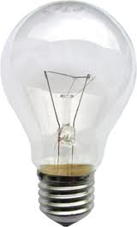
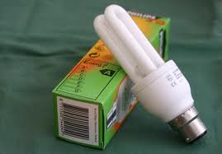
Which uses more power?
Notes:
Slide 5
Between a standard light bulb and an energy saving bulb
Answer: Energy saving bulb

Slide 6
Which uses more power?
Notes:
Slide 6
Between a kettle and a TV
Answer: kettle
Note: This is the tricky example because the kettle is only on a for a few minutes, this is why use of correct terminology is needed for this section. Explain if both on for same amount of time the kettle uses more.

Slide 7
Which uses more energy in a year in an average household?
1
3
2
Notes:
Slide 7
This slide is about Total Energy consumption NOT Power
-From the previous examples: which one of these now uses more energy in a year?
1) TV- LCD £51.23
2) Kettle- £16.90
3) Energy saving ,light bulbs- £2.63
http://www.carbonfootprint.com/energyconsumption.html
Note: The numbers will replace the pictures

Slide 8
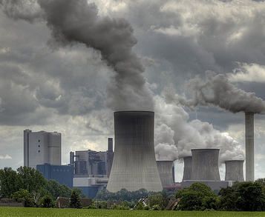
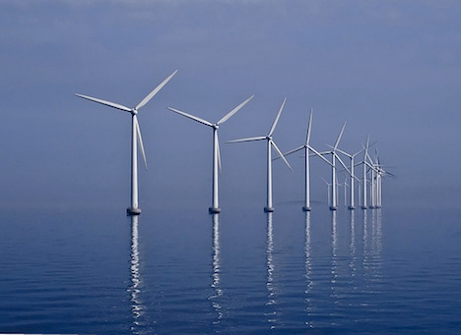
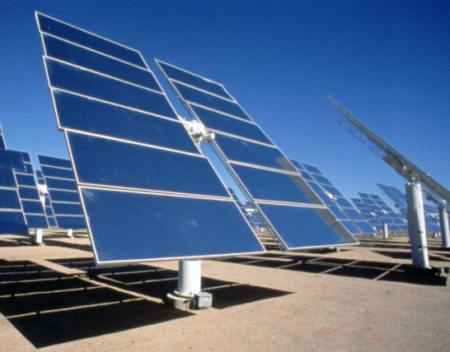
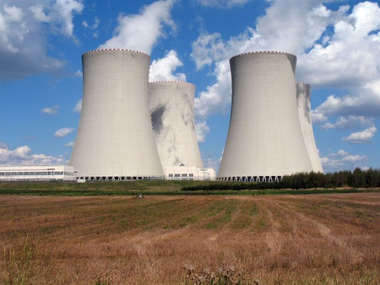
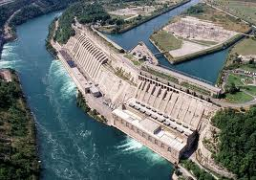
How is electricity produced?
Coal
Wind
Sun
Nuclear
Water
8
Notes:
Slide 8 – How is electricity produced?
This slide again is an interactive question and answer slide.
-Your looking to get the students to suggest different kinds of power stations
-After the class has run out of ideas, go through the answers on the slide

Slide 9
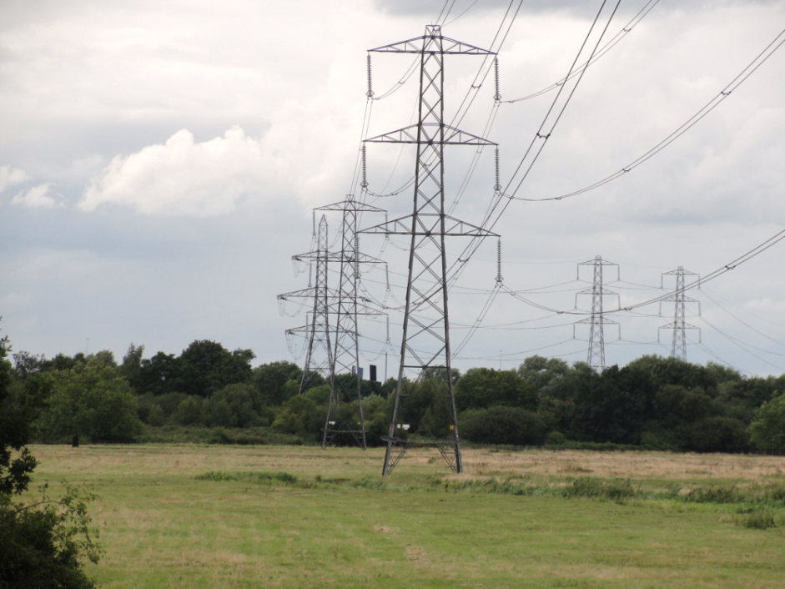
How does electricity get from where it is made to us?
This system is called the National Grid
9
Notes:
Slide 9
-We know where electricity comes from but ‘how does it reach us from the power station?
-This is just a lead up to the starter activity, so don’t linger too much talking about the National Grid.
For a 60 min session do say how in places like Kenya the national grid doesn’t reach everyone. Ask if they have any ideas how else they could get electricity. Show the posters form Practical Action to highlight the 4 main ways energy is available to small communities in rural areas in the developing world. Omit slides 10 and 11

Slide 10
Let’s make our own National Grid
10
Notes:
Slide 10 – Starter Activity
Starter Activity Slide 1
-Keep it very brief on this slide, the point to get across is that we are all connected to the National Grid here in the UK and they will be replicating that.

Slide 11
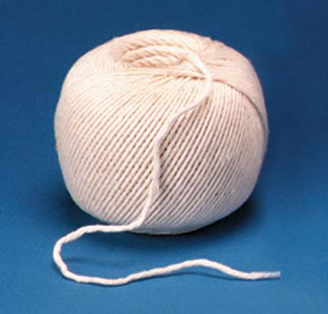
Your task:
Imagine each of you is an electricity pylon, and the string is the wires, connect as many people as possible to the power source.
11
Notes:
Slide 11
Starter Activity Slide 2
-This slide is just a brief description of the task, refer to the sections starter activity for more info on how to run this task

Slide 12
Technology Justice
1.4 billion people don’t have any electricity that’s one third of the world
33%
1/3
Is this fair?
We don’t think so. We believe everyone has the right to technology that means they can lead a decent life… as long as it doesn’t harm other people or the environment, now or in the future. We call that Technology Justice.
Notes:
Slide 12
After the starter activity, we move onto Technology justice along with the info on the slide try get this message across:
“If you believe everyone has the right to something as important as electricity then like us you believe in technology justice. This is everyone’s right to have the technologies that they need to live a decent life”.

Slide 13
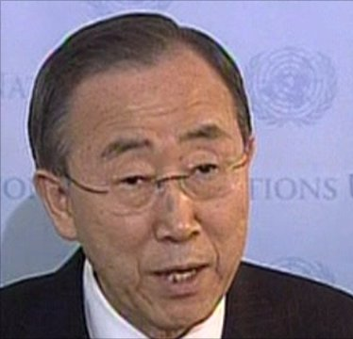
What is being done to help people in the developing world e.g. Kenya?
In year 2015 world leaders got together and said they wanted to help people in developing countries like Kenya get out of poverty and lead a decent life.
They set themselves 17 different goals to make this happen by 2030. They called these the
Sustainable Development Goals
General Ban Ki Moon
United Nation’s General Secretary
Notes:
Slide 13– What can be done about this problem?
Keep this brief on The MDGs
-Ask if anyone has heard of the MDGs before and what they are?
-Go on to explain how they were set to make a big difference to reducing poverty in the world

Slide 14
Why is electricity so important for Technology justice?
…let’s find out why one charity called Practical Action thinks electricity is important and what they are doing to make technology justice a reality.
http://www.youtube.com/watch?v=usISdE-WSWU
Notes:
Slide 14
This slide includes a video from practical action:
http://www.youtube.com/watch?v=usISdE-WSWU
Introduce the video, as a showcase of the problems and some solutions to the problems of a lack of electricity

Slide 15
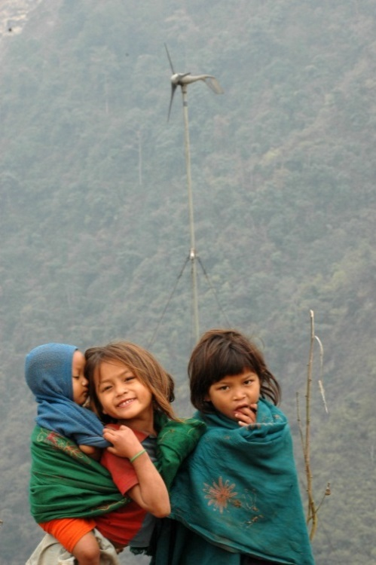
Today we are focusing on using wind power to produce electricity
Wind turbines convert wind into electricity
Wind turbines can provide energy for communities not connected to the national grid…reaching the very poor.
Wind is a renewable energy source, so it is sustainable… it doesn’t harm other people or the environment.
Notes:
Slide 15
Try get across the benefits of wind power, this links in nicely with the starter activity as it can be used on a small scale to provide electricity to those not connected to the national grid and that wind energy is Renewable.

Slide 16
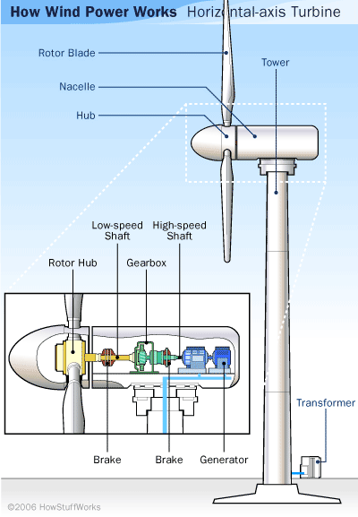
How does a wind turbine work?
A wind turbine works In the same way as a fossil fuel power station.
The only difference is wind turns the generator rather than heated steam
This makes a wind turbine renewable, as the wind is an energy source which will never run out
Notes:
Slide 16
How does a wind turbine work:
-The same as a conventional power station, however the wind turns the generator not steam
-Thus a wind turbine is renewable
For more details on Wind Power see:
https://www1.eere.energy.gov/wind/wind_how.html

Slide 17
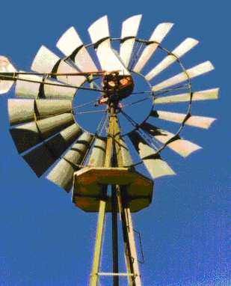
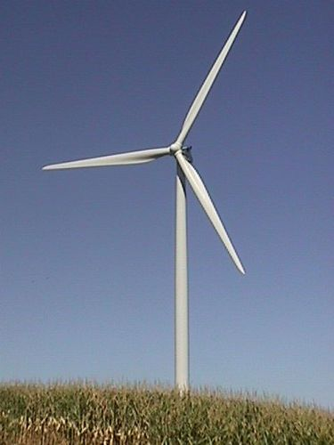
Different kinds of wind turbines
There are many different kinds of turbines, each with different features
Notes:
Slide 17
The main point to stress is that a wind turbine is built to be fit for purpose.
As this slide comes just before the main activity, volunteers should discuss how a wind turbine with MANY blades is better for Mechanical work (i.e lifting objects) compared to a 3 bladed one used for generation of electricity.

Slide 18
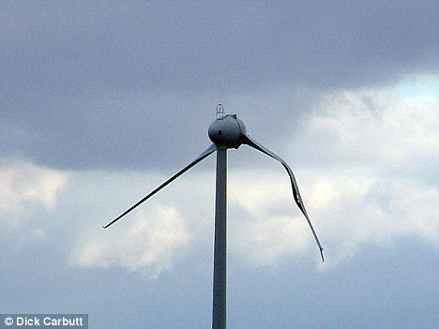
Your task…
A set of wind turbine blades has broken in your community, you need to design and build replacement blades
Notes:
Slide 18 – Main activity
Main Activity Slide 1
-Use this slide to talk about the task the students have
-Hand out the instruction sheets and allowing reading time before moving to the next slide
For an example of what happens when a wind turbine goes wrong show video
http://www.youtube.com/watch?v=-YJuFvjtM0s&feature=player_embedded

Slide 19
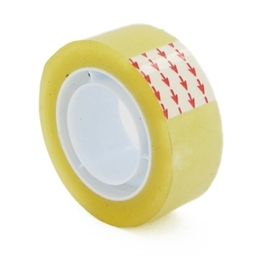
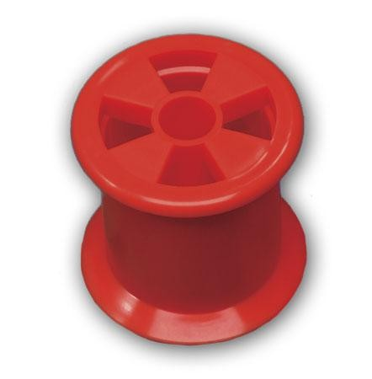
Your materials…
Notes:
Slide 19
Main Activity Slide 2
-Use this slide to talk about the materials and time the students have to complete the task
-Hand out The materials whilst the students are reading the activity briefs
For more details on the task see the main activity section of this Pack.

Slide 20
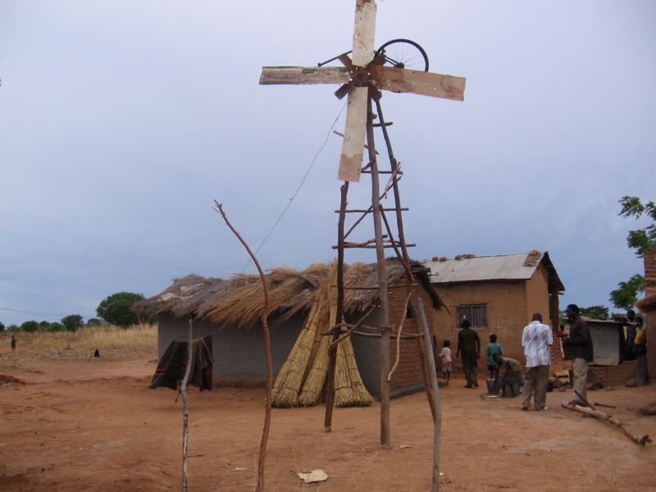
A wind turbine in rural Africa
Notes:
Slide 20 – Finishing the session
A Wind turbine built by William kamkwamba when he was just 14 in Rural Africa
Using a book he found and very little money, he attempted to rebuild the ‘windmill’ he had read about
For More details of the story see:
http://en.wikipedia.org/wiki/William_Kamkwamba
Message to get across: If he can do it so can you!

Slide 21
Enjoyed the workshop? What’s next?
Take part in one of Practical Action’s STEM challenges
www.practicalaction/STEM
See how you could become an engineer working renewable energy
www.practicalaction.org/careers
Spread the word Tell other people at school and at home what you have learnt

Slide 22
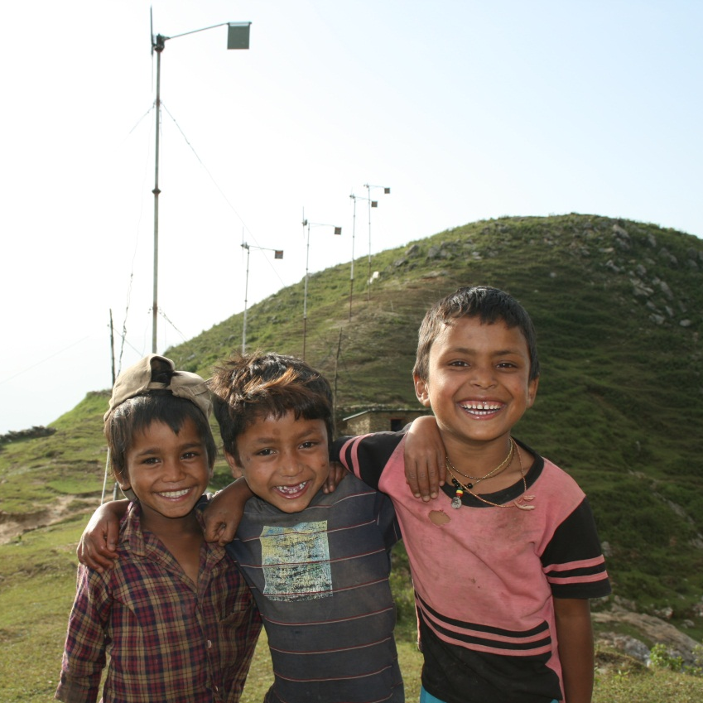
…any questions?
Notes:
Slide 22

