Slide 1
Learning Objectives
To increase knowledge and understanding of the importance of water
To understand the ideas of ‘embodied water’ and ‘water footprint’
To consider your own water footprints and water use

Slide 2
Why is water important?
https://www.youtube.com/watch?v=kxqbpPWTl6A
Watch this short film then answer the questions

Slide 3
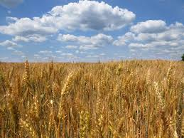
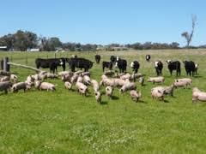
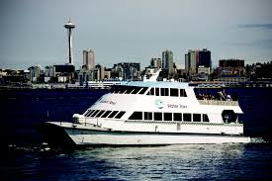
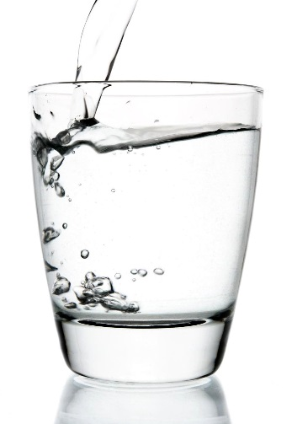
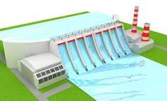
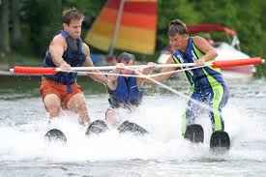
Why is water important?
What do we use water for?
Drinking, transport, electricity, farming, recreation.

Slide 4
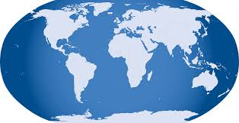
Why is water important?
How much of the world is covered by water in seas and oceans?
70% earth covered in water, most of that is in the oceans.

Slide 5
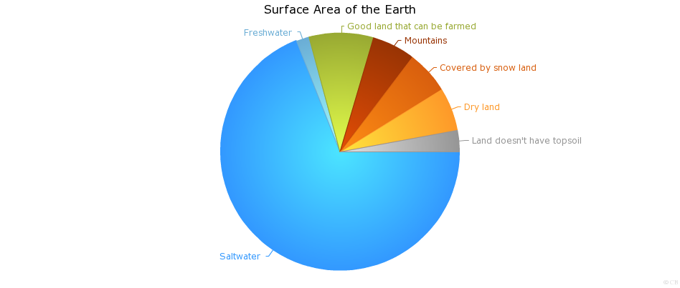
Why is water important?
How much of the world’s water is freshwater?
Less than 3% world’s water is freshwater.

Slide 6
Why is water important?
How much of the freshwater is available for humans to use?
Less than 1/3 of the world’s freshwater is available for humans to use?

Slide 7
Why is water important?
We use water for drinking, transport, electricity, farming, recreation.
70% earth covered in water, most of that is in the oceans.
Less than 3% world’s water is freshwater.
Less than 1/3 of the world’s freshwater is available for humans to use.

Slide 8
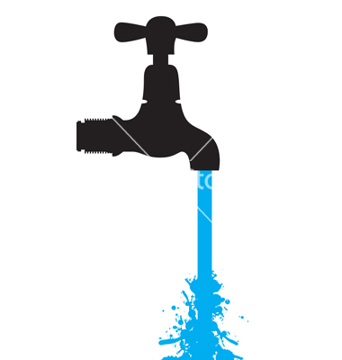
Why is water important?
Freshwater consumption is forecast to increase globally by 25% by 2030.
By 2025 2/3 of world population will be in water stressed areas
(water stressed means when annual water supplies drop below 1700 m³ per person)

Slide 9
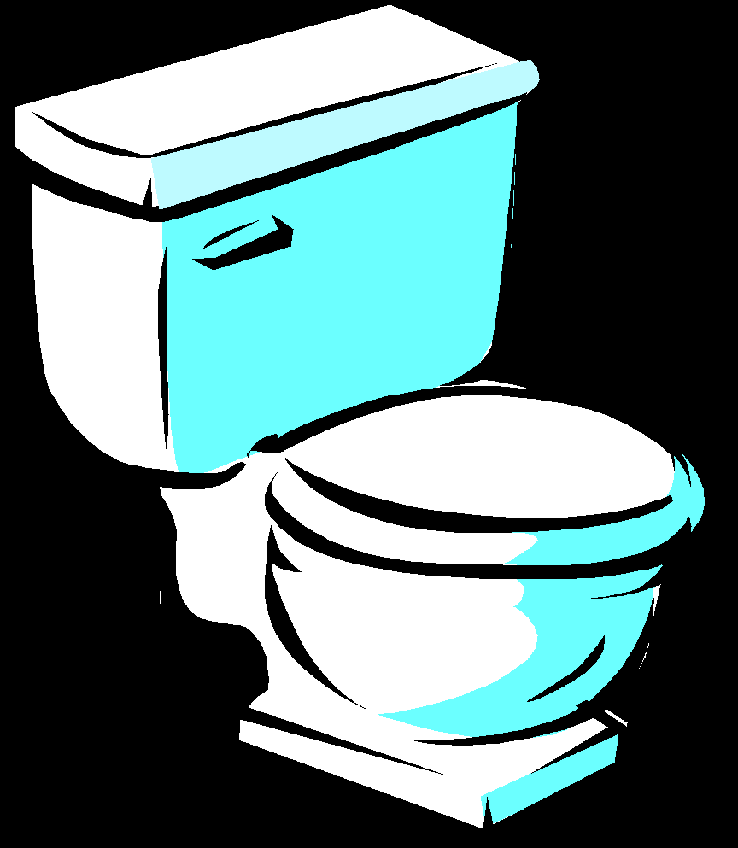
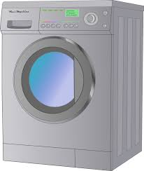
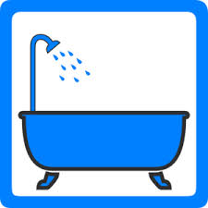
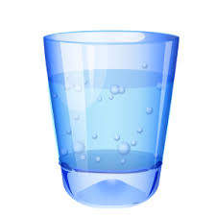
Why is water important?
What have you used water for so far today?

Slide 10
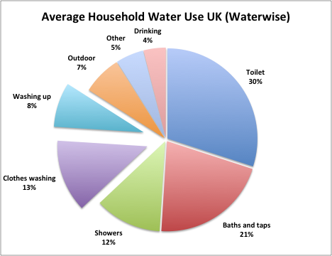
Why is water important?

Slide 11
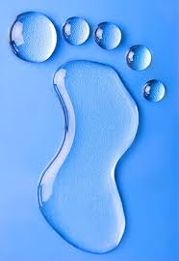
Have you heard of a carbon footprint?
The amount of carbon dioxide released into the atmosphere
as a result of the activities of an individual, e.g. travel, food,
housing.
What is a water footprint?
The amount of fresh water used
in the production or supply of
goods and services used by an individual

Slide 12
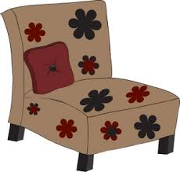
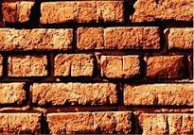
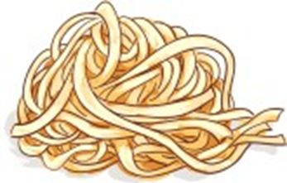
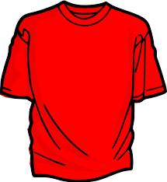
Water footprint includes ‘Embodied Water’
'Embodied water' is the amount of water used during the growing, processing and transportation of the goods we use or consume, or the services we use.
Some of the items we take for granted in our lives – food, clothing, furniture and many building materials have very high embodied water content.

Slide 13
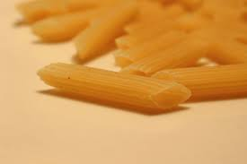
Embodied water example
Pasta
To eat a bowl of pasta
The grain has to be grown (through rain or irrigation)
The grain is processed into pasta which requires water as an ingredient and to clean the machines after making it
The pasta is then packaged (water is used in the packaging manufacture and the printing process)
The pasta and packaging is then transported to the supermarket with the transport using water from coolant in the motor to washing the vehicle
Finally, you have to cook pasta in a pot of water
All of these steps use water

Slide 14
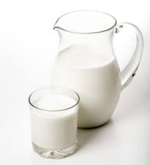
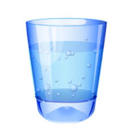
Embodied Water card game
Sort the cards from the highest to the lowest embodied water content (litres per kilogramme)
Put an amount from 10 litres to 20,000 litres next to each card
Clues…
1000 litres of to make 1 litre
6000 litres to make 1 kilogramme of

Slide 15
Embodied Water card game
17200 Chocolate
15500 Beef
3200 Cheese
2500 Rice
2400 Hamburger
1850 Pasta
1600 Bread
1260 Pizza
1020 Milk
1020 Juice
820 Apple
790 Banana
560 Orange
287 Potatoes
210 Tomatoes

Slide 16
Water footprint exercise
Look at the two graphs on the worksheet
and answer the questions.

Slide 17
Reducing Water footprint
How could you reduce your water footprint (think about embodied water and water use in general)?

Slide 18
Use the workbook to record your responses
What did I learn in this lesson?
How does Ethical Science or Technology
Justice apply to this lesson?
OR
Reflect on the use of science for good in water use

