Slide 1
Science4Society week is a collection of science education activities, focusing on the positive contribution that science, design and technology can make to peace, social justice and environmental sustainability.

Slide 2
Science can be defined as…
‘intellectual and practical activities covering the systematic study of the structure and behaviour of the physical world through observation and experiment’
Technology can be defined as…
‘the adaptation of scientific knowledge for practical purposes’

Slide 3
Use the workbook to record your responses
(keep it with your homework diary)
today – in this session
during this week – in all of your lessons
(mainly science)
next week – bring it to next week’s
tutor session

Slide 4
Ethical Science is…
Consider one of these pairs of words…
Good – Bad
Right – Wrong
Just – Unjust
Ethical – Unethical
Moral – Immoral
How might these apply to Science?
(2 minute discussion in pairs)

Slide 5
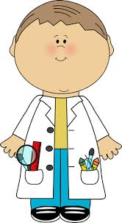
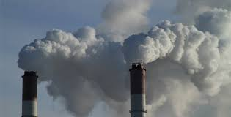
Ethical Science – is it about…
the person and what they think?
the organisation they work for?
what they actually do?
the results of what they do?

Slide 6
Start of 20th century – life expectancy globally –
less than 40 years of age.
Now the world average is 70… Why?
Improved…
sanitation – construction of sewers, treatment of drinking water
housing – to reduce overcrowding, damp and poor ventilation
diet – fresher food, pasteurisation of milk, food preservation (e.g. canning)

Slide 7
Tackling poverty has been most effective.
Curing diseases with antibiotics and vaccines has only made a small contribution.
Cures found in 20th Century include:
Malaria Measles
Whooping Cough Tetanus
Rabies Polio

Slide 8
Ethical Science – think about
the person, the organisation, actions, results
Is it always ethical to fund more medical research?
(2 minute discussion in pairs)

Slide 9
Ethical Science – Is it always ethical to fund more medical research?
What if the person/organisation just
wants to make money from it?
What if they use animals to test
their cures?
What if the cures are only available
to people who can afford them?
What if more money is spent on keeping
people healthy? E.g. exercise or nutrition advice

Slide 10
Technology Justice is where… ‘Everyone has the right to access the technologies they need to live the life they value without limiting the ability of others now and in the future to do the same’
What technologies you have accessed so far today?
e.g. bus, car, bike? Laptop, tablet, mobile phone? Toaster, microwave, kettle? House, heating system, toilet?
Which technologies do you need?
(2 minute discussion in pairs)

Slide 11
Who is everyone? What does right to access mean?
What technologies do people need?
Does technology have any negative effects on the environment as its being made, used or disposed of?
Does technology have any negative effects on people as its being made, used or disposed of?
Are there any long term effects of the use, production or disposal of technology that cause long term impact on future generations?
(Choose one of these - 2 minute discussion in pairs)

Slide 12
In your lessons this week think about…
Ethical Science
The person, the organisation, actions, results
Technology Justice
‘Everyone has the right to access the technologies they need to live the life they value without limiting the ability of others now and in the future to do the same’

Slide 13
Use the workbook to record your responses
today
during this week – in all of your lessons
(mainly science)
next week - bring it to next week’s
tutor session)

