Slide 1
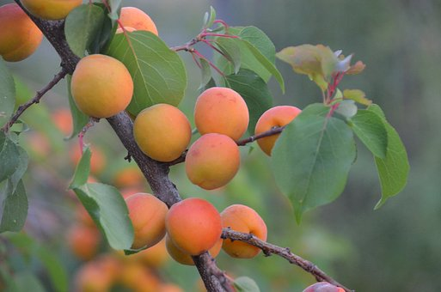
Sustainable Food production
Lesson1/2
https://pixabay.com/photos/apricot-tree-regenerative-agriculture-3384306/
Notes:
https://pixabay.com/de/photos/aprikose-baum-3384306/

Slide 2
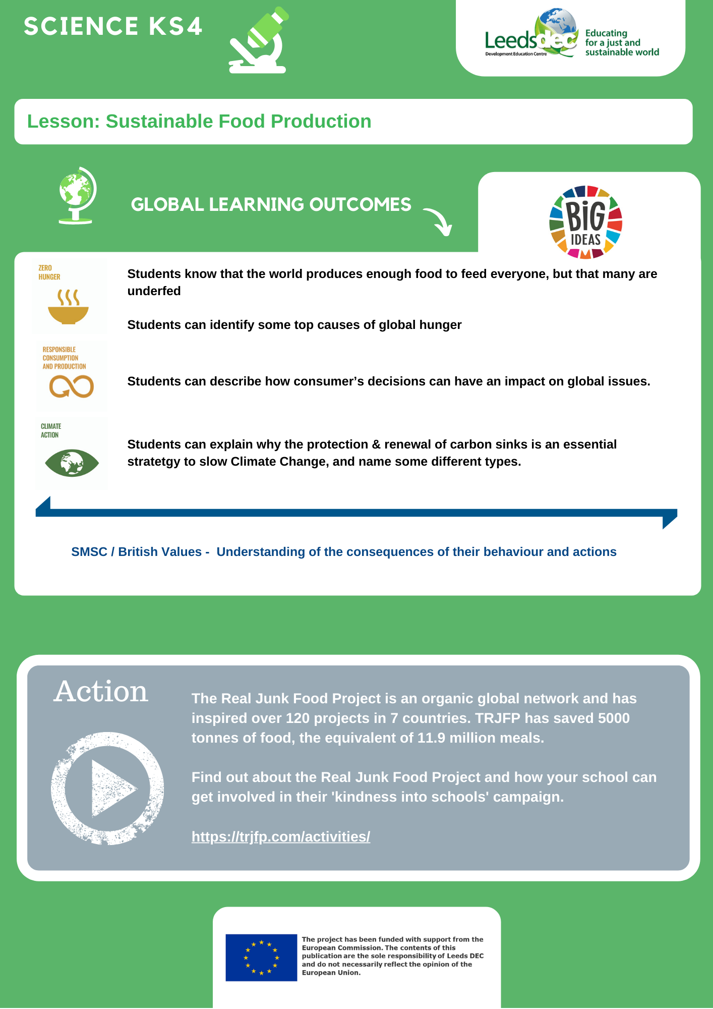
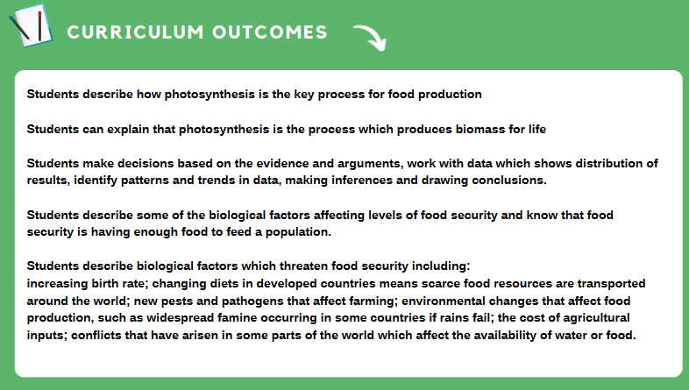

Slide 4
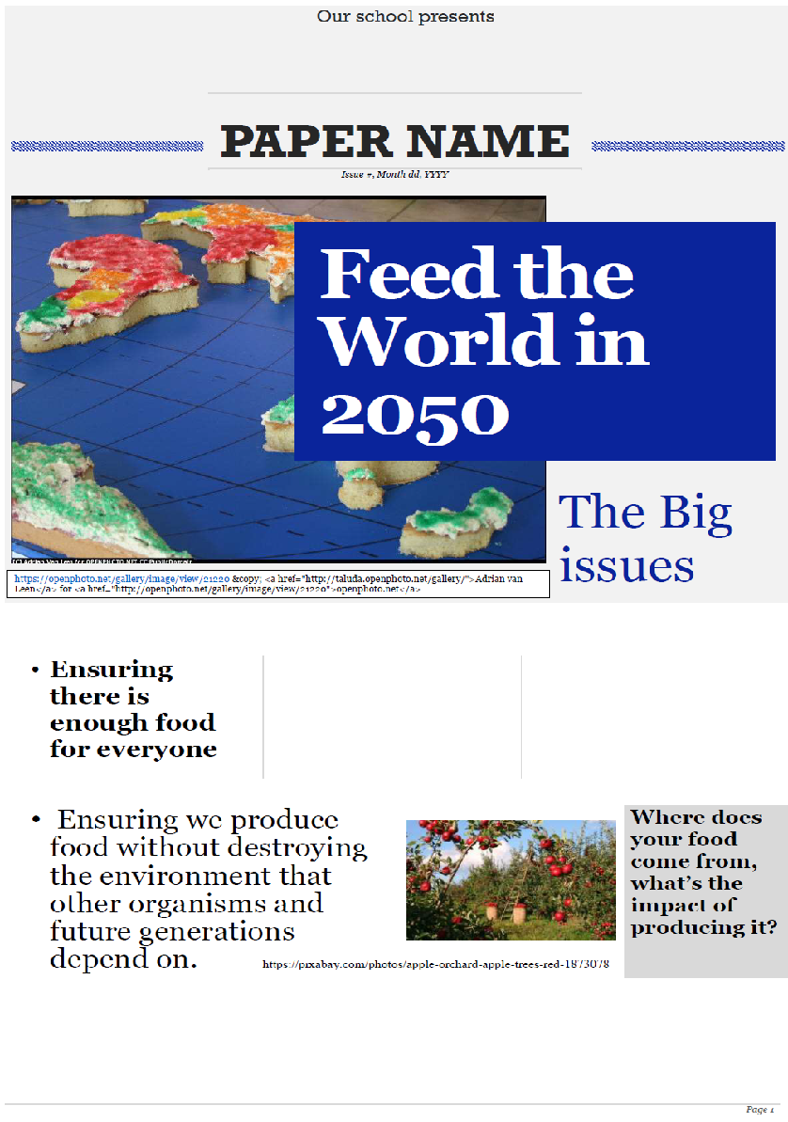

Slide 5
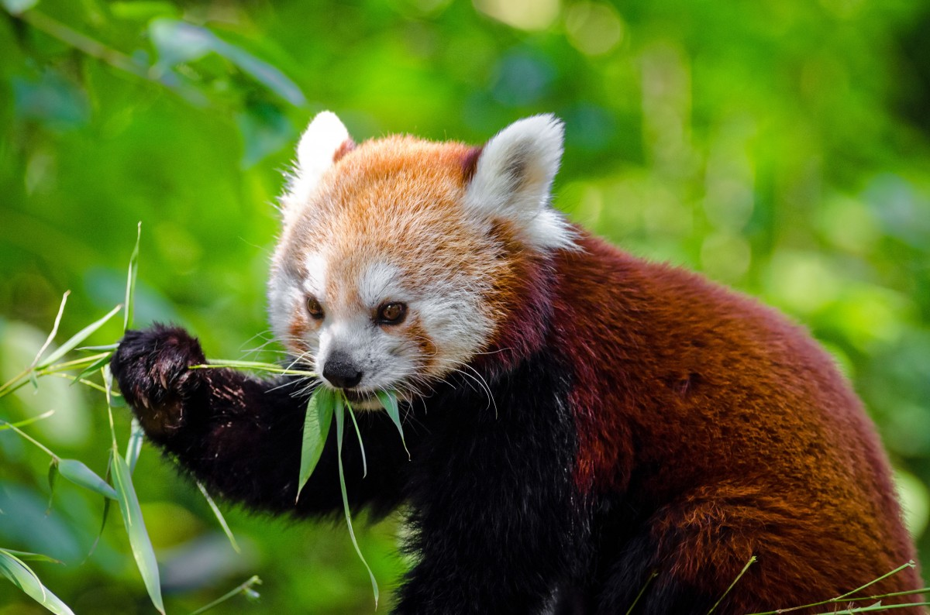
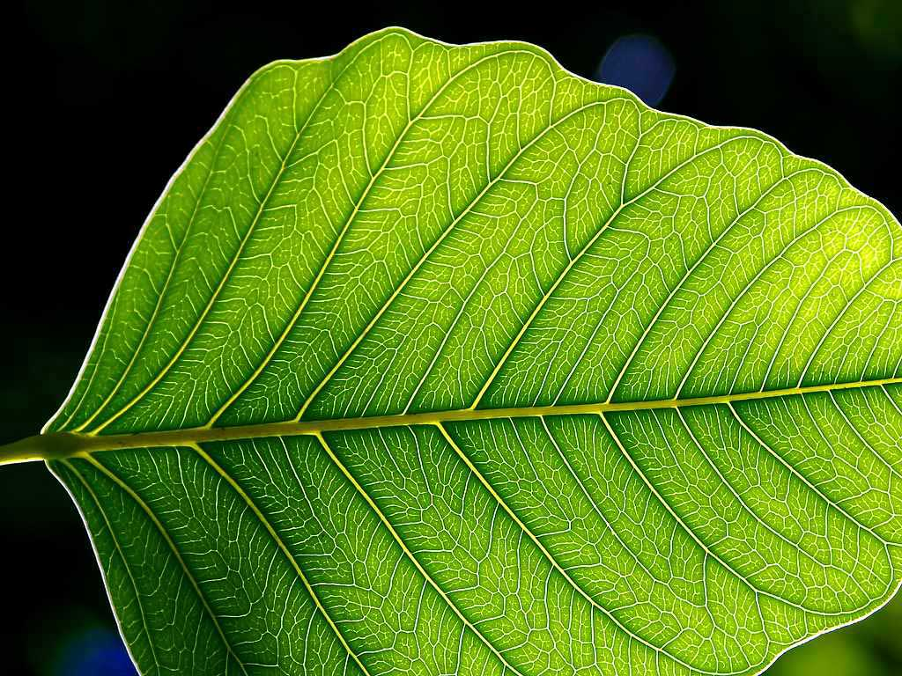
Where do animals get their food?
Where do plants get their food?
No attribution necessary
https://pxhere.com/en/photo/856319
Cc https://en.wikipedia.org/wiki/Plant

Slide 6
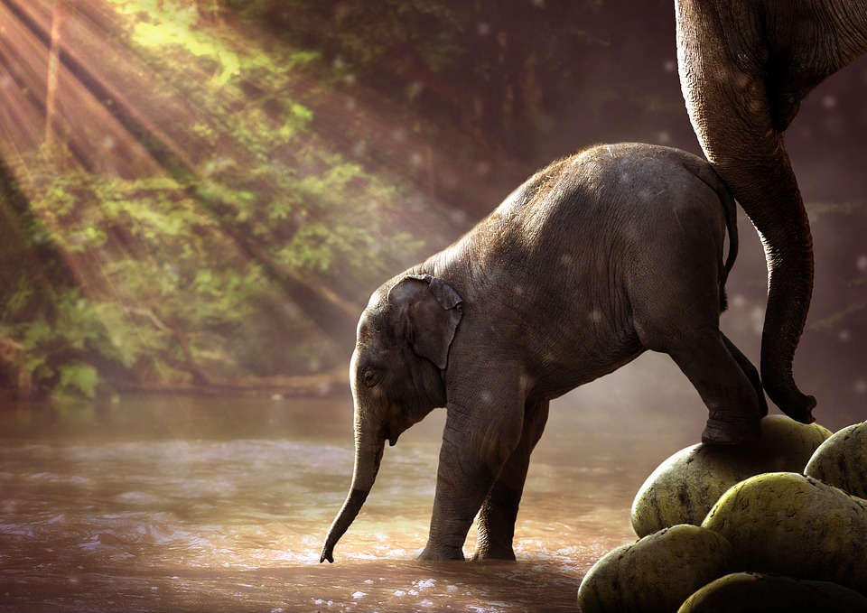
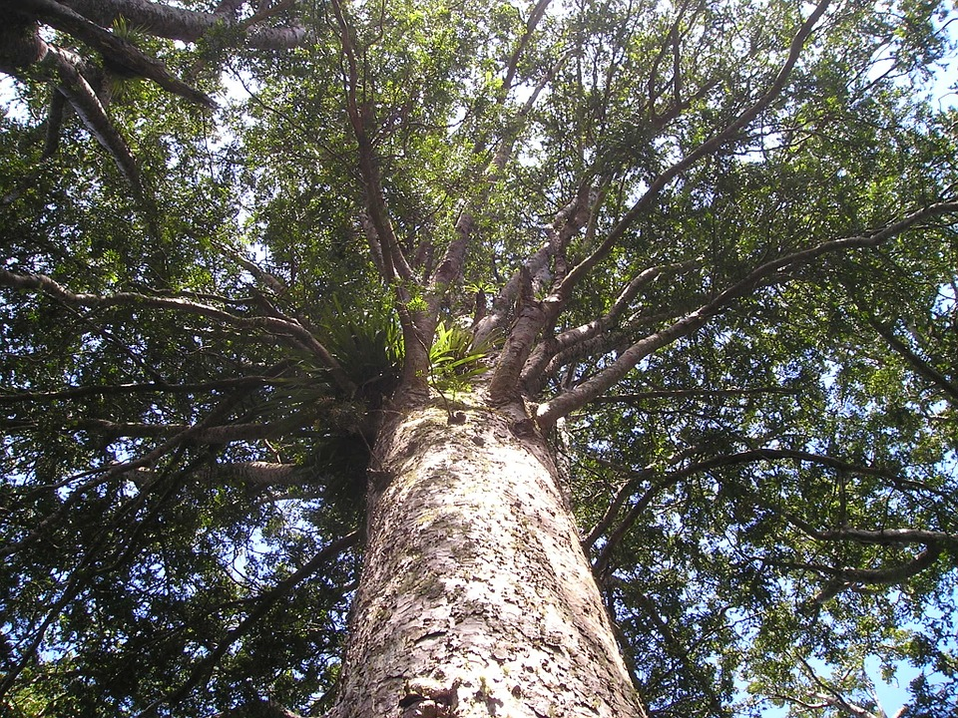
Where does the mass of an animal come from?
Where does the mass of a plant come from?
No attribution necessary
https://pixabay.com/photos/
elephant-young-watering-hole-2380009/
No attribution necessary .
https://pixabay.com/photos/
kauri-tree-giant-tree-huge-i-76/

Slide 7
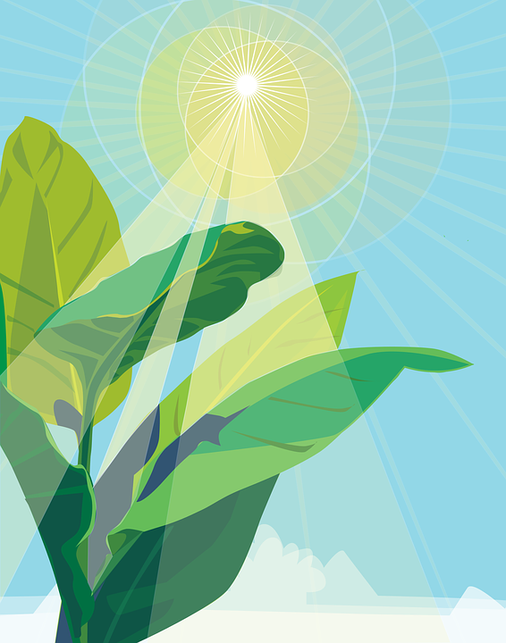
Agree or disagree?
Photosynthesis is the chemical reaction which feeds the planet.
The mass of all life on the planet (biomass) comes from the CO₂ and H₂O which plants use in photosynthesis.
glucose
water
Carbon dioxide
oxygen
https://pixabay.com/illustrations/plant-photosynthesis-sunlight-leaf-3759893/

Slide 8
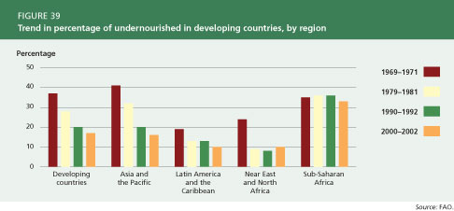
GOOD NEWS
In the last 20 years the number of undernourished people in the world has dropped by almost half.
But 1 in 9 people on the planet are still chronically undernourished.
https://commons.wikimedia.org/wiki/File:Trend_in_percentage_of_undernourished_
people_in_developing_countries,_by_region.jpg

Slide 9
Sort the factors which contribute to hunger and lack of food security into biological and non-biological factors
the increasing birth rate has threatened food security in some countries.
changing diets in developed countries means scarce food resources are transported around the world
new pests and pathogens that affect farming
Climate change and its environmental changes that affect food production, such as widespread famine occurring in some countries if rains fail or crops are flooded.
the cost of agricultural inputs such as fertiliser
conflicts that have arisen in some parts of the world which affect the availability of water or food.
A decline in pollinator insects such as bees
Over consumption of food in developed countries.
Using land and crops to feed to animals bred for food
poverty and inequality rather than shortages affect access to food

Slide 10
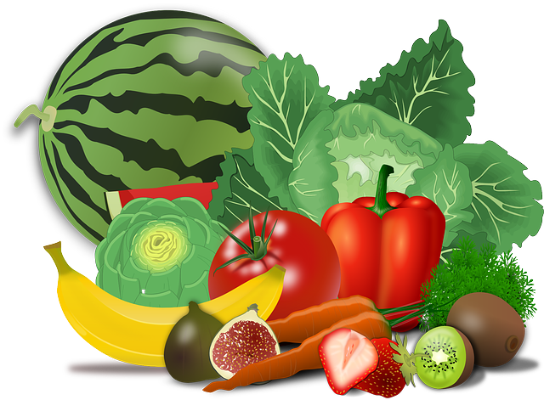
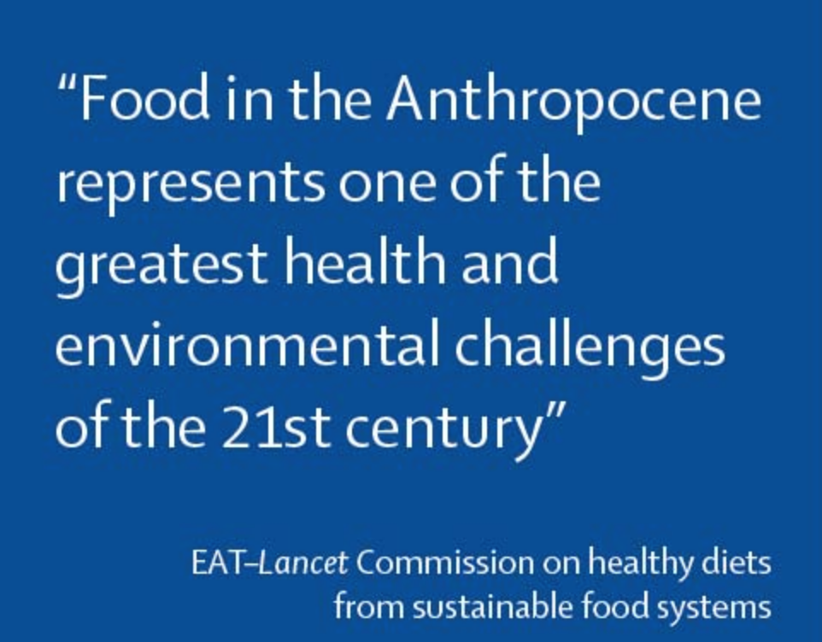
Challenge - changing the way we eat and grow food.
What is meant by the Anthropocene
List as many health and environmental challenges associated with food as you can.
Notes:
Important for students to look at the impact of meat consumption as a challenge of sustainable food production and consumption.

Slide 11
The challenge
Sustainable food production should provide enough food for about 10 billion people should use no additional land, safeguard existing biodiversity, reduce consumptive water use and manage water responsibly, substantially reduce nitrogen and phosphorus pollution, produce zero carbon dioxide emissions, and cause no further increase in other greenhouse gases such as methane and nitrous oxide.
Give yourself 10 points for each one you got!

Slide 12

Identify one change which you could undertake to make your diet more sustainable.

Slide 13
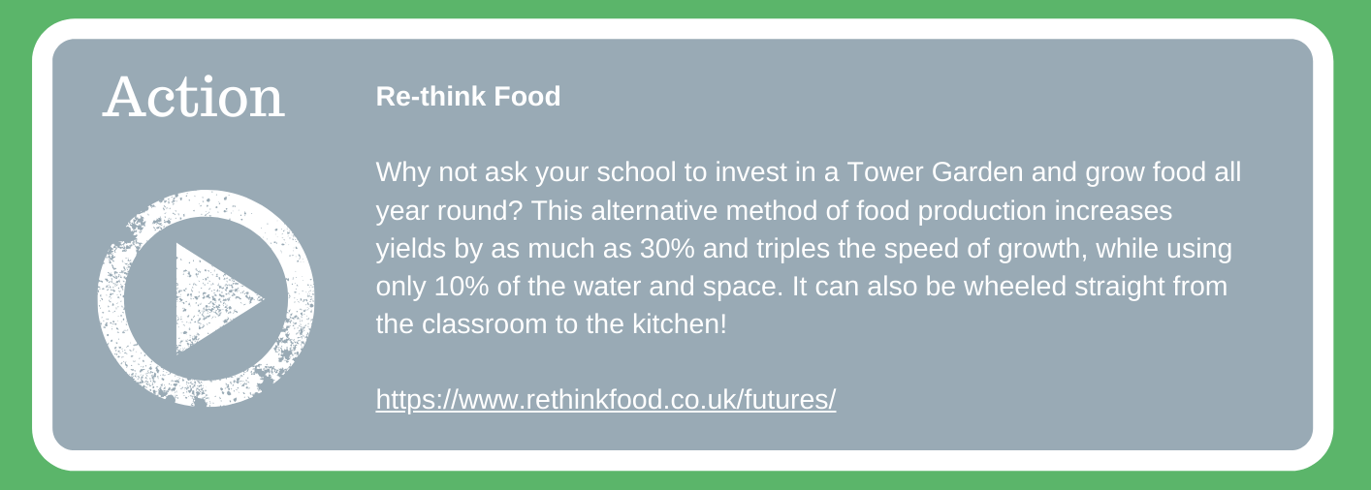

Slide 14


World Class Teaching project has been funded with support from the European Commission. The contents of these actions are the sole responsibility of the contractor and can in no way be taken to reflect the views of the European Union.

